Slide 1
Unit-3 User Interface Design

Slide 2
Unit – 3: User Interface Design
User interface design:
The Golden rules
User interface analysis and design
Interface analysis
Interface design steps
Design evaluation
Notes:
Later on models are translated into implementation.
Advantage in documentation
Product designers build models to show their customers, Visualization: advertisement, Reduction in complexity: to understand system which are complex
Abstraction is incomplete, inaccurate, but captures crucial aspects of a system, it limits the universe so we can understand.
Don’t search absolute truth, but for adequecy for some purpose.

Slide 3
3.1 Introduction
Any computer based system requires two things i.e. computational ability and functionality.
As computer based system is used by casual users, the purpose of user interface design is to have effective communication medium between the computerized system and user.
This kind of interface design is necessary because of many reasons such as:
Software is difficult to use
The use of software forces the users to make mistakes due to lack of understanding about the system.
Notes:
Later on models are translated into implementation.
Advantage in documentation
Product designers build models to show their customers, Visualization: advertisement, Reduction in complexity: to understand system which are complex
Abstraction is incomplete, inaccurate, but captures crucial aspects of a system, it limits the universe so we can understand.
Don’t search absolute truth, but for adequecy for some purpose.

Slide 4
Continued…
While designing the user interface the very first step is to identify user, tasks and environmental techniques.
Based on user tasks, user scenarios are prepared which help to define user interface objects and corresponding actions.
This set of objects and actions help in deciding the screen layout.
Once such layout has been prepared, appropriate icons, screen text and menu items can be placed at respective positions.

Slide 5
3.2 Concepts of UI
Thao Mandel has proposed three Golden Rules for UI design:
Place the user in control
Reduce the user’s memory load
Make the interface consistent
While analysing any requirement during requirement analysis the user often demands for the system which will satisfy user requirements and help him to get the things done. Following are some design principles that allow user to control system:
Define the interaction mode in such a way that user will be restricted from doing unnecessary actions

Slide 6
3.2.1 Place the user in control
While analysing any requirement during requirement analysis the user often demands for the system which will satisfy user requirements and help him to get the things done.
Following are some design principles that allow user to control system:
Define the interaction mode in such a way that user will be restricted from doing unnecessary actions
Interaction mode means the current state in which user is working and being such a mode user is supposed to do the related tasks only if the user has perform unnecessary actions at such time then the GUI becomes frustrating.
Provide the facility of ‘undo’ or ‘interruption’ in user interaction
This is the feature which allows the user to correct himself whenever necessary without losing his previous work. E.g. in the “Paint” software one can draw objects and perform ‘redo’ or ‘undo’ operations to get desired drawing.

Slide 7
Continued…
Allow user to customize the interaction
It is observed that while handling user interface certain actions need to be done repeatedly. It saves the time if these actions are collected in a macro.
Hide technical details from the user
This feature is essential for casual user. User should not be aware of system commands, operating system or file management functions. E.g. showing icons of print, open, save etc. in place of commands.
The objects appearing on the screen should be interactive with the user
It means that user should be in position to adjust the object appearing on the screen. E.g. In ‘Paint’ one should be able to stretch the oval or edit the text written in the object.

Slide 8
3.2.2 Reduce the User’s Memory Load
If the user interface is good then user has to remember very less.
The design should be such that the system remembers more for the user and ultimately it assists user to handle computer based system.
Following are some principals to reduce memory load of user:
Do not force user to have short term memory
When user is involved in complex task then he has to remember more. The user interface should be such that the user need not have to remember past action and results. This can be achieve by proper visual interface.
Establish meaningful defaults
Meaningful default options should be available to user. E.g. In the Microsoft word user can set default font size as per choice. There should be reset option available to the user in order to get back the original values.

Slide 9
Continued…
Use intuitive shortcuts
For quick handling of system such shortcuts are required in user interface. E.g. ‘control + s’ is used to save the file in all office products. Hence, use of meaningful mnemonics is necessary while designing in interface.
The visual layout of interface should be realistic
When certain feature of system needs to be highlighted then use if proper visual layout helps casual user to handle the system with ease. E.g. in an online purchase pictures of visa cards are given then it guides user to understand payment process.
Disclose the information gradually
There should not be bombarding of information on user. It should be presented to user in systematic manner. Fro instance, one can organize the information in hierarchical manner and narrate it to user. At the top level of such hierarchical structure the information should be in abstract form and in bottom more detailed description is given.

Slide 10
3.2.3 Make the Interface Consistent
The user interface should be consistent. This consistency is maintained at three levels such as follow:
The visual information should be consistent throughout and it should be as per design standards.
There should be limited set of input holding non conflicting information.
The information flow from one task to another should be consistent.
Following are some principals for consistent interface design:
Allow user direct the current task into meaningful manner
This principal suggests that create a user interface with proper indicators on it so that user can understand his current task and how to proceed for new task.

Slide 11
Continued…
Maintain consistence across family of product
If an application come in a packaged manner then every product of that application family should posses the consistent user interface. E.g. Microsoft Office family products has several applications such as MS word, MS excel and so on. The interface of each of this product is consistent. That means there is title bar, menu bar having menus like File, Edit, View etc. on every product’s interface. Then tool bar and then design layouts are placed on interface.
If certain standards are maintained in previous model of application do not change it until and unless it is necessary
Certain sequence of operation becomes a standard for the user, then do not change these standards because user becomes habitual with such practices. For instance, control + s is for saving the file then it has become a standard rule. Now, if any other shortcut key is allowed for save or control + s used for some other purpose then it becomes annoying for customer.

Slide 12
User Interface Analysis and Design

Slide 13
3.3 Interface Design Model
User interface analysis and design can be done with the help of following steps:
Create different models for system functions
In order to perform these functions identify the human-computer interface tasks
Prepare all interface designs by solving various design issues
Apply modern tools and techniques to prototype the design
Implement design model
Evaluate the design from end user to bring quality in it
These steps can be broadly categorized in two classes
Interface analysis and design models
The process

Slide 14
3.3.1 Interface Analysis & Design Model
There are four types of models that can be prepared in interface analysis and design.
User Model
To design any user interface it is a must to understand the user who is using the system. Hence, in this model the profile of user is prepared by considering age, education and cultural background. The software engineer prepares user model. There are three kinds of users
User model | Design model | Mental model (System Perception) | Implementation model
User | Description
Novice | User with little knowledge of computer who simply knows semantics of system & doesn’t know implementation of such system
Knowledge & intermittent | User having knowledge about the semantics of system as well as having little knowledge of syntactic of system
Knowledge & Frequent | The user with good semantic as well as good syntactic knowledge of the system

Slide 15
Design Model
It consists of data, architectural interface and procedural representation of software. While preparing this model requirement specification must be used properly to set the constraints. Software engineer prepares the design model of the interface.
Mental Model (System Perception)
User model is representation of what user thinks about system. Any user interface design is heavily dependant on description obtained from user about his needs. If the user is knowledgeable then more complete description of system can be obtained by novice user.
Implementation Model
This model generates the look and feel of interface. This model describes the system’s semantic and syntax. It is very necessary to match the implementation model with the user’s mental model then only user can feel comfortable with developed system.
The interface designer has to resolve differences within these models. The principal followed by interface analysis and design method is: ‘know the user and know the task’.

Slide 16
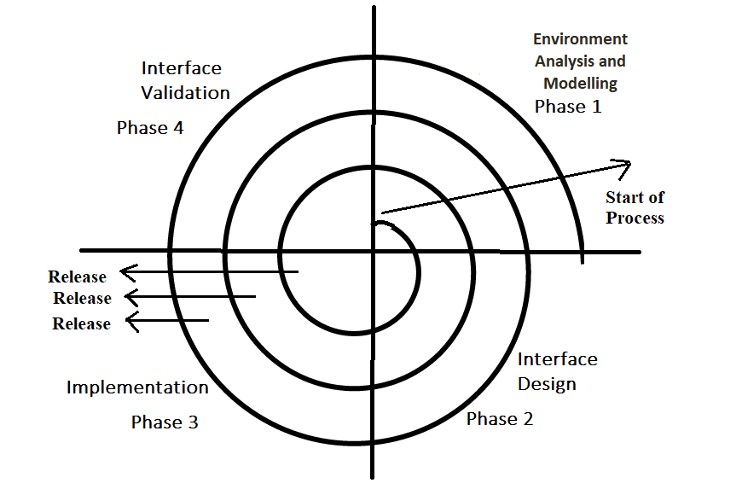
3.3.2 The Process
The user interface analysis and design process can be implemented using interactive spiral model. As shown in figure each task can be performed more than once. At each pass around the system more requirements can be elaborated and detailed design can be performed.

Slide 17
It consists of four framework activities.
Environment analysis and modelling
In this phase, major factors are focused i.e. user, task and environment. First, the user profile is analysed to understand the user and to elicit the requirements, then the tasks that are required to carry out desired functionality are identified and analysed.
The analysis is made on user environment which involves physical work environment. Finally analysis model created for the interface. This model serves as a basis for the design of user interface.
Interface design
The interface design is a phase in which all the interface objects and corresponding actions of each task are defined.

Slide 18
It consists of four framework activities.
Implementation
The implementation phase involves creation of prototype using which the interface scenarios can be evaluated.
To accomplish the construction of user interface some automated tools can be used.
Interface validation
The goal of validation is to validate the interface for its correct performance.
During validation it is tested whether all the user requirements get satisfied or not.
The purpose of validation is also to check whether the interface is easy to learn and to use.

Slide 19
Interface Analysis

Slide 20
Interface Analysis
A key tenet of all software engineering process models is this: understand the problem before you attempt to design a solution. In the case of user interface design, understanding the problem means understanding:
The people (end users) who will interact with the system through the interface. [User Analysis]
The tasks that end users must perform to do their work. [Task Analysis and Modeling]
The content that is presented as part of the interface. [Analysis of Display Content]
The environment in which these tasks will be conducted. [Analysis of the Work Environment]

Slide 21
Continue…
(1) User Analysis
The phrase user interface is probably all the justification needed to spend some time understanding the user before worrying about technical matters. The following set of questions will help you to better understand the users of a system:
Are users trained professionals, technicians, clerical, or manufacturing workers?
What level of formal education does the average user have?
Are the users capable of learning from written materials or have they expressed a desire for classroom training?
Are users expert typists or keyboard phobic?
What is the age range of the user community?
Will the users be represented predominately by one gender?
How are users compensated for the work they perform?
Do users work normal office hours or do they work until the job is done?
Is the software to be an integral part of the work users do or will it be used only occasionally?
What is the primary spoken language among users?
What are the consequences if a user makes a mistake using the system?
Are users experts in the subject matter that is addressed by the system?
Do users want to know about the technology that sits behind the interface?

Slide 22
Continue…
(2) Task Analysis and Modeling
The goal of task analysis is to answer the following questions:
What work will the user perform in specific circumstances?
What tasks and subtasks will be performed as the user does the work?
What specific problem domain objects will the user manipulate as work is performed?
What is the sequence of work tasks—the workflow?
What is the hierarchy of tasks?
To answer these questions, the following techniques are applied to the user interface.
Use Cases
Task Elaboration
Object Elaboration
Workflow Analysis

Slide 23
Continue…
(d) Workflow Analysis
When a number of different users, each playing different roles, makes use of a user interface, it is sometimes necessary to go beyond task analysis and object elaboration and apply workflow analysis.
Workflow can be represented effectively with a UML Swimlane diagram
(a variation on the activity diagram).

Slide 24
Continue…
Swimlane Diagram
In a business model, it is often useful to know which human department is responsible for an activity.
When design of the system is complete, the activity will be assigned to a person/department, but at a high level it is sufficient to partition the activities among departments.
You can show such a partitioning with an activity diagram by dividing in to columns and lines.
Each column is called swim-lane by analogy to a swimming pool.
Placing an activity within a particular swim-lane indicates that is performed by a person/ department.
Lines across swim-lane boundaries indicate interaction among different person/department.

Slide 25
Continue…
How to Draw a Swimlane Diagram
Step 1: Identify the various activities and actions your business process or system
Step 2: Figure out which person/departments are responsible for the competition of activity.
Step 3: Figure out in which order the actions are processed.
Step 4: Figured out who is responsible for each action and assign them a swimlane and group each action they are responsible for under them

Slide 26
Swimlane Diagram for Book Issue
Check availability book
[book not available]
Alert “Book not available”
[book available]
Validate Member
[unauthorized user]
Alert “not a valid member”
[authorized user]
No. of books issued to member
[max limit]
Alert “No more book can be issued”
[else]
Add book issue details to transaction
Update no of book issued to member
Update book status

Slide 27
Continue…
(3) Analysis of Display Content
During this interface analysis step, the format and aesthetics of the content (as it is displayed by the interface) are considered. Among the questions that are asked and answered are:
• Are different types of data assigned to consistent geographic locations on the screen (e.g., photos always appear in the upper right-hand corner)?
• Can the user customize the screen location for content?
• Is proper on-screen identification assigned to all content?
• If a large report is to be presented, how should it be partitioned for ease of understanding?
• Will mechanisms be available for moving directly to summary information for large collections of data?
• Will graphical output be scaled to fi t within the bounds of the display device that is used?
• How will color be used to enhance understanding?
• How will error messages and warnings be presented to the user?
The answers to these (and other) questions will help you to establish requirements
for content presentation.

Slide 28
Continue…
(4) Analysis of the Work Environment
“People do not perform their work in isolation. They are influenced by the activity around them, the physical characteristics of the workplace, the type of equipment they are using, and the work relationships they have with other people.”
In some applications the user interface for a computer-based system is placed in a “user-friendly location” (e.g., proper lighting, good display height, easy keyboard access), but in others (e.g., a factory floor or an airplane cockpit), lighting may be suboptimal, noise may be a factor, a keyboard or mouse or touch screen may not be an option, display placement may be less than ideal.

Slide 29
Interface Design Steps

Slide 30
Interface Design Steps
Many different user interface design models have been proposed, all suggest some combination of the following steps:
Define interface objects and actions (operations)
Identify events (user actions) that will cause the state of the user interface to change
Depict the representation of each state
Indicate how the user interprets each state from information provided through the interface.
Applying Interface Design Steps
User Interface Design Patterns
Design Issues

Slide 31
Continue…
Applying Interface Design Steps
The definition of interface objects and the actions that are applied to them is an important step in interface design. A use case is written. Nouns (objects) and verbs (actions) are isolated to create a list of objects and actions.
Example: SafeHome system
Preliminary use case: I want to gain access to my SafeHome system from any remote location via the Internet. Using browser software operating on my notebook computer (while I’m at work or traveling), I can determine the status of the alarm system, arm or disarm the system, reconfigure security zones, and view different rooms within the house via preinstalled video cameras.

Slide 32
Continue…
Applying Interface Design Steps
Based on this use case, the following homeowner tasks, objects, and data items are identified:
• Accesses the SafeHome system
• Enters an ID and password to allow remote access
• Checks system status
• Arms or disarms SafeHome system
• Displays floor plan and sensor locations
• Displays zones on floor plan
• Changes zones on floor plan
• Displays video camera locations on floor plan
• Selects video camera for viewing
• Views video images (four frames per second)
• Pans or zooms the video camera
Objects (boldface) and actions (italics) are extracted from this list of homeowner tasks.

Slide 33
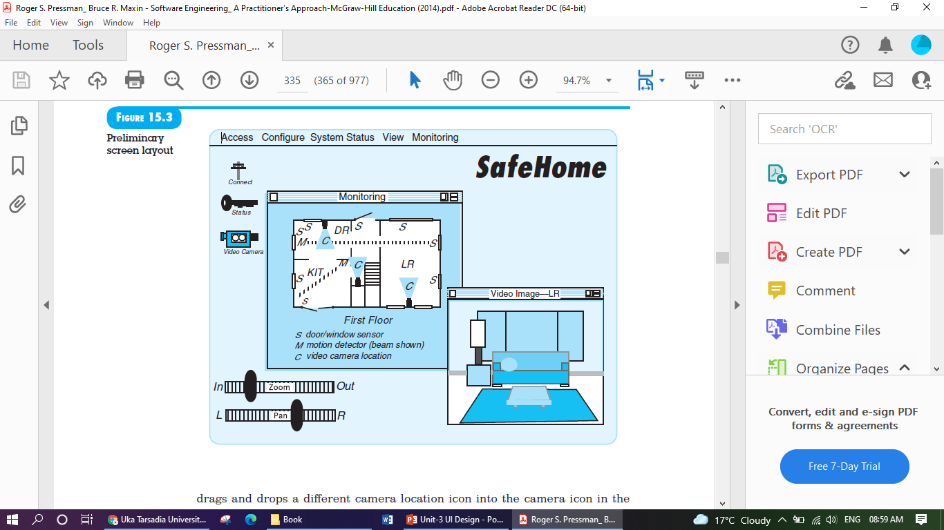
Continue…

Slide 34
Continue…
(2) User Interface Design Patterns
Graphical user interfaces have become so common that a wide variety of user interface design patterns has emerged. A design pattern is an abstraction that prescribes a design solution to a specific, well-bounded design problem.
Laakso [Laa00] suggests a pattern called CalendarStrip that produces a continuous, scrollable calendar in which the current date is highlighted and future dates may be selected by picking them from the calendar. The calendar metaphor is well known to every user and provides an effective mechanism for placing a future date in context.
(3) Design Issues

Slide 35
Continue…
(3) Design Issues
It is far better to establish each as a design issue to be considered at the beginning of software design, when changes are easy and costs are low.
System Response Time
Help Facilities
Error Handling
Menu and Command Labelling
Application Accessibility
Internationalization

Slide 36
Design Evaluation
The implementation phase of user interface includes creation of prototype that enables user to evaluate usage scenarios.
Preliminary
Design
Builds 1st Prototype
Build n^{th} Prototype
User Evaluation Interface
Design Modifications are done
Study of Evaluation done by User
Interface design is complete

Slide 37
This evaluation is necessary to determine whether created interface satisfies user demands or not.
After evaluating the usage scenario the user immediately submits his comments to the designer.
The designer then makes corresponding modification in the interface and then again it is submitted to further evaluation.
This design evaluation of user interface is an iterative process.
After creation of first prototype it is evaluated by the user.
The evaluation made by the user is then submitted to the designer who then make necessary changes in interface and builds the next prototype.
This process is repeatedly performed until the user gets satisfied completely and no further modifications are necessary in interface.
Thus prototype approach proves to be effective for design evaluation.

